Slide 1
FLIGHT MANAGEMENT SYSTEM
By:- Ayushi Shrivastava
Harshleen Kaur
Nisha Sharma
Varun Sharma

Slide 2
OBJECTIVE
The console based “Flight Management system” project is an attempt to stimulate the basic concepts of flight reservation system. The system enables the customer to do the things such as search for airline flights for two travel cities to choose a flight based on the details, reservation of flight and cancellation of reservation.

Slide 3
TECHNOLOGIES USED
JAVA,JDBC
SQL
HTML,CSS,JAVASCRIPT

Slide 4
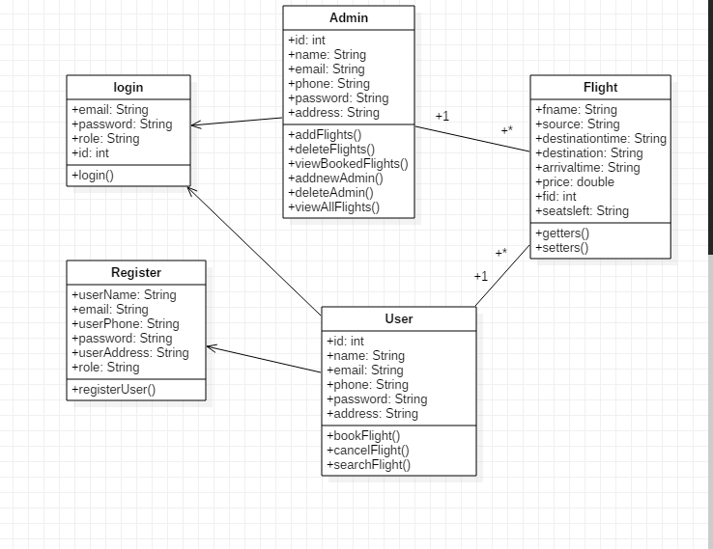
CLASS DIAGRAM

Slide 5
MODULES
There are basically three modules:
Admin module
User Module
Database Module

Slide 6
USER MODULE:
User can perform the following functions:
Register
Login
Search Flights
Book Seats
Cancel Flights

Slide 7
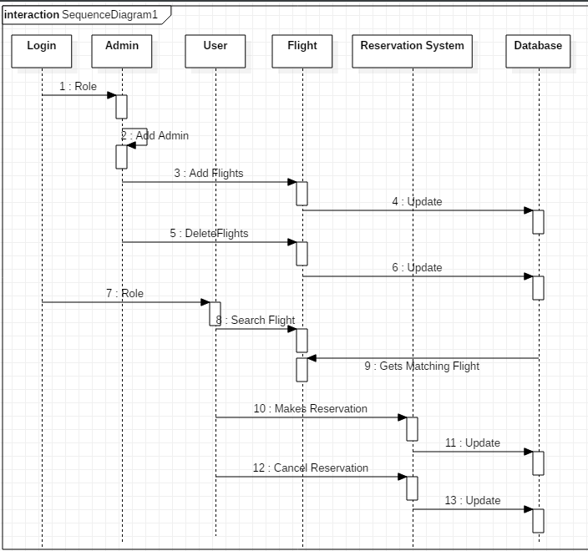
SEQUENCE DIAGRAM

Slide 8
ADMIN MODULE
Admin can perform the following functions:
Add another admin
Add Flights
Delete Flights

Slide 9
DATABASE MODULE
It consists of three tables:
Login table – Allows to register new user and login registered user.
Flight table – Contains the information of flights.
Booking table- Stores the information of booked seats and total price paid by the user.

Slide 10
THANK YOU

